Slide 1

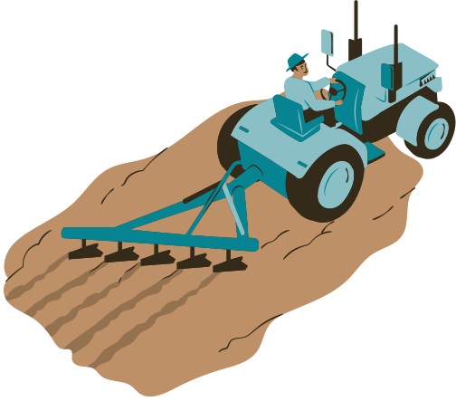


SMART
AGRICULTURE
3 SEP, 2025
PRESENTED BY BNU STUDENTS
SMART FARMING WITH AI GROWS MORE FOOD USING LESS LAND, WATER, AND EFFORT

Slide 2


CHALLENGES
IN AGRICULTURE
TODAY’S FARMING FACES CLIMATE CHANGE, WATER SCARCITY, HIGH COSTS, AND HEAVY LABOR DEMANDS
Climate change and unpredictable weather.
Soil degradation and water scarcity.
Pests and diseases.
Land availability and urbanization.

Slide 3
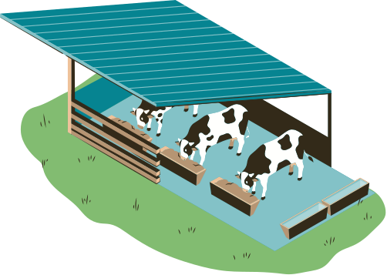
CHALLENGE
DISEASES
A large share of crops is wasted each year due to plant diseases
The lack of skilled workers to manage these diseases makes the problem even worse

Slide 4
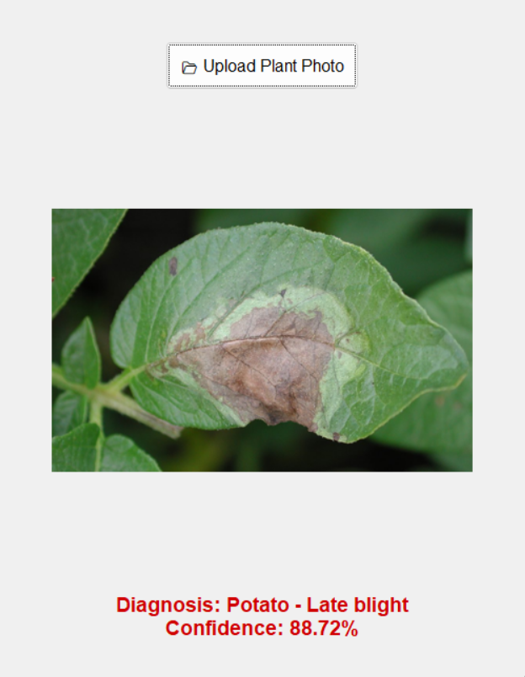

AI
TESTS

Slide 5
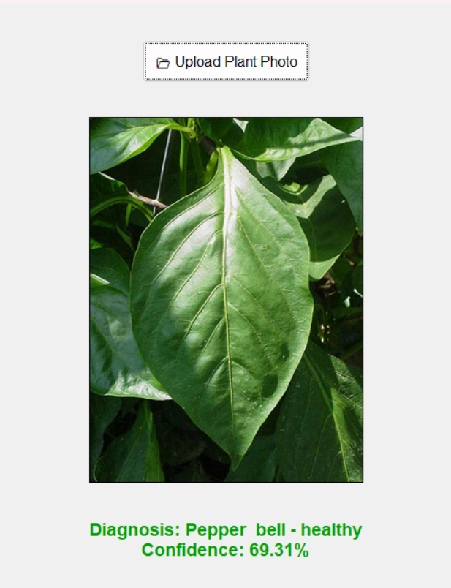
AI
TESTS

Slide 6
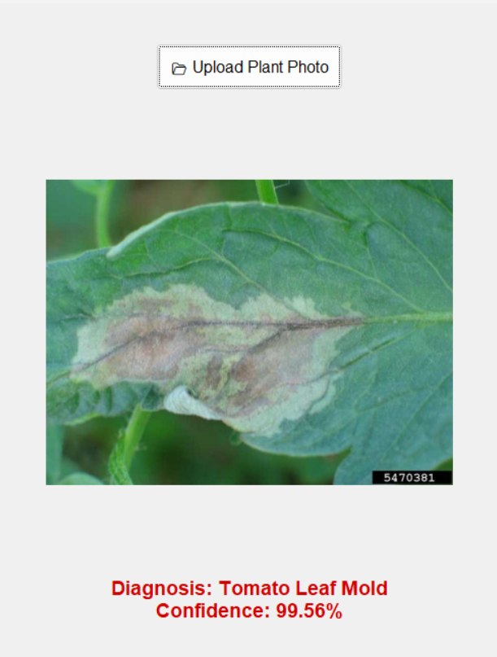
AI
TESTS

Slide 7

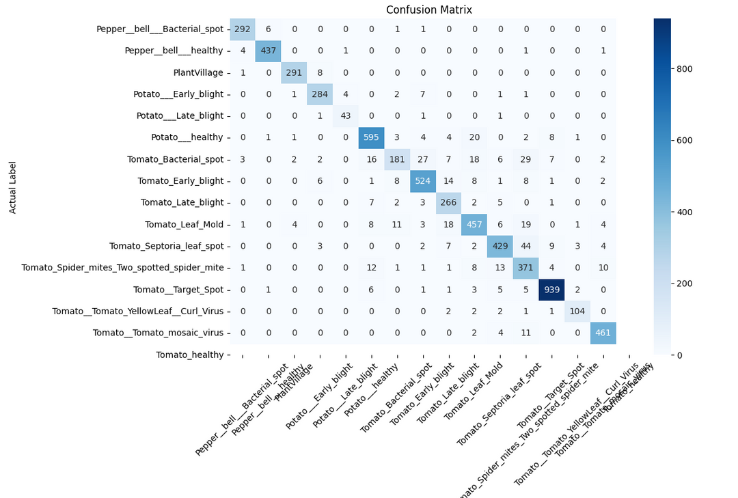
AI
STATISTICS

Slide 8
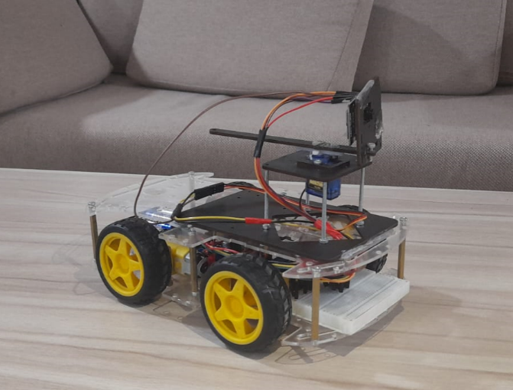
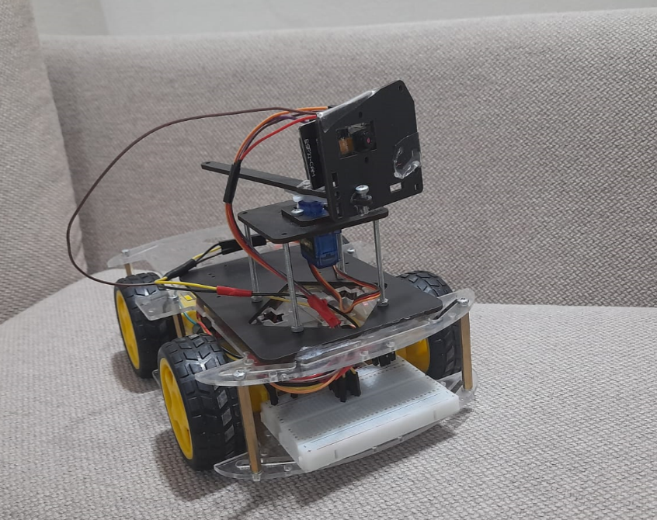

CAR

Slide 9
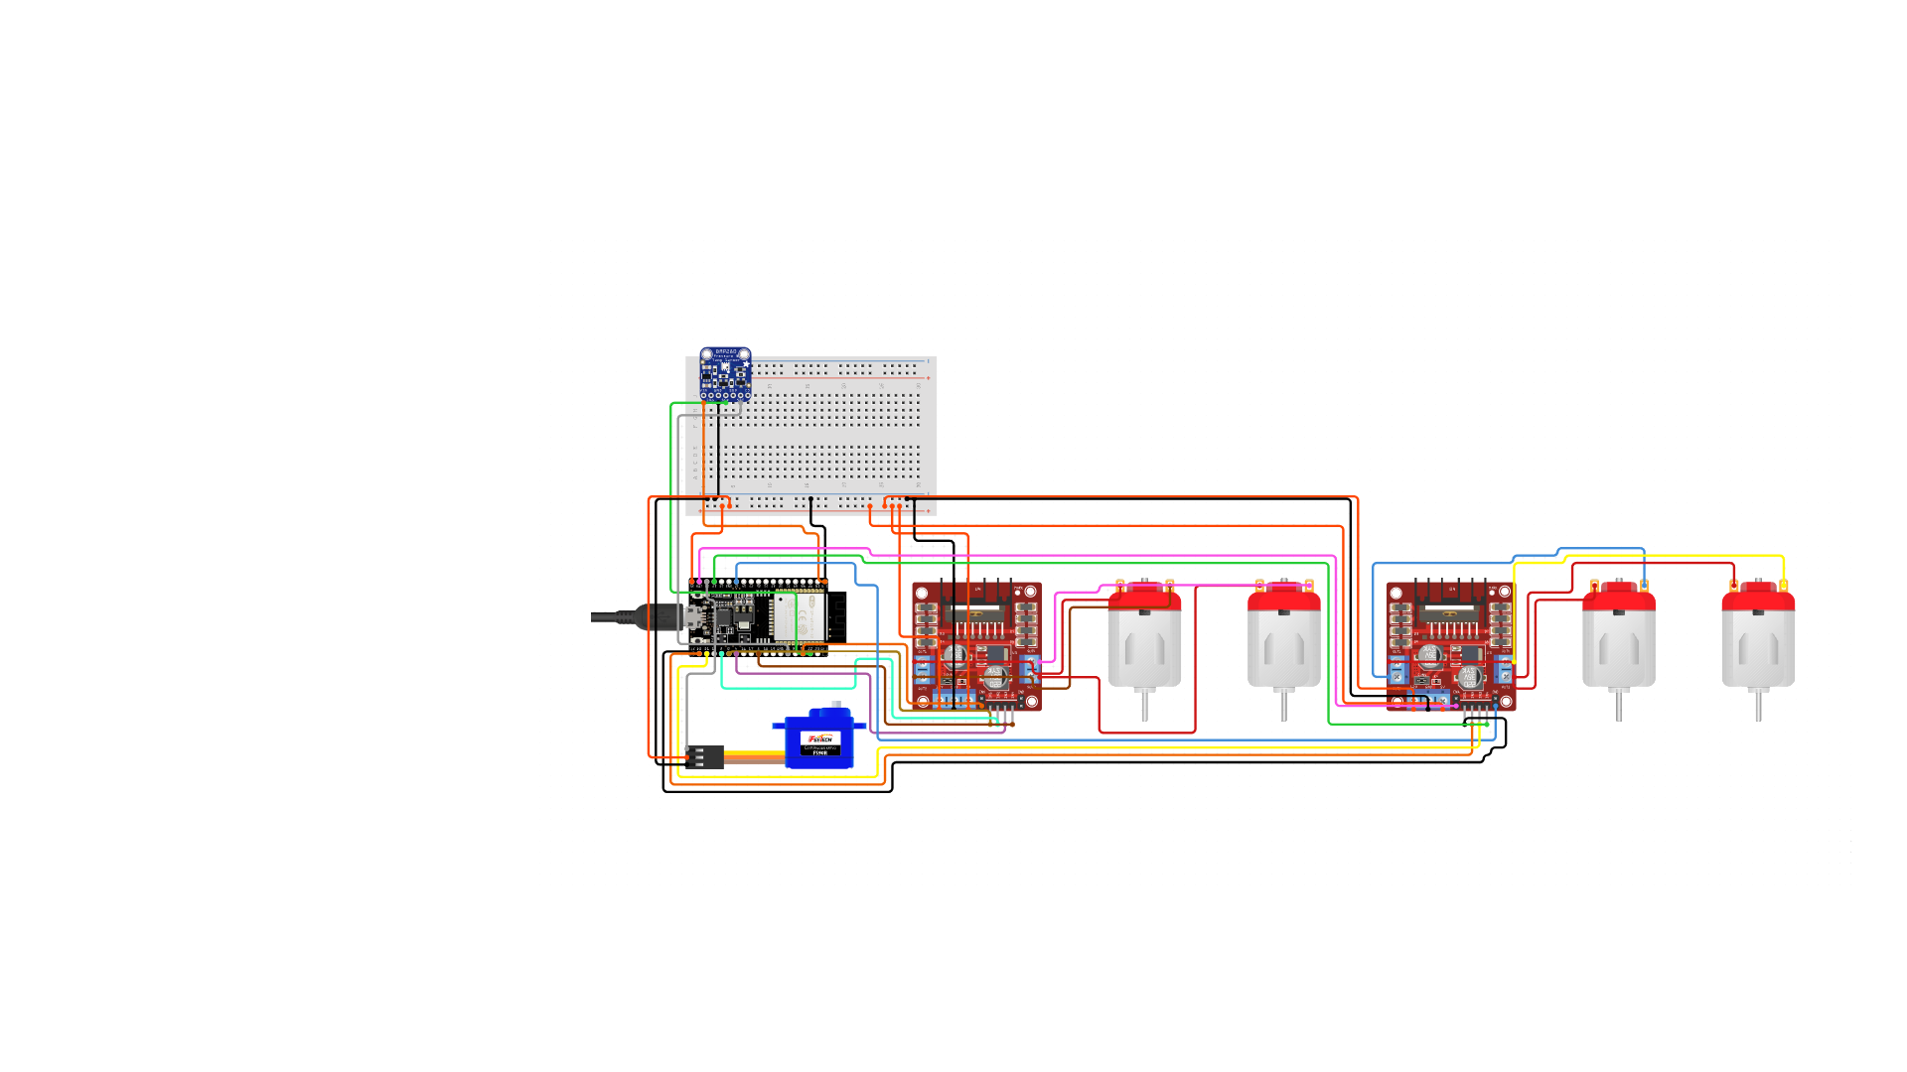

CAR
CIRCUIT

Slide 10

OPTIMAL FIT FOR

Slide 11
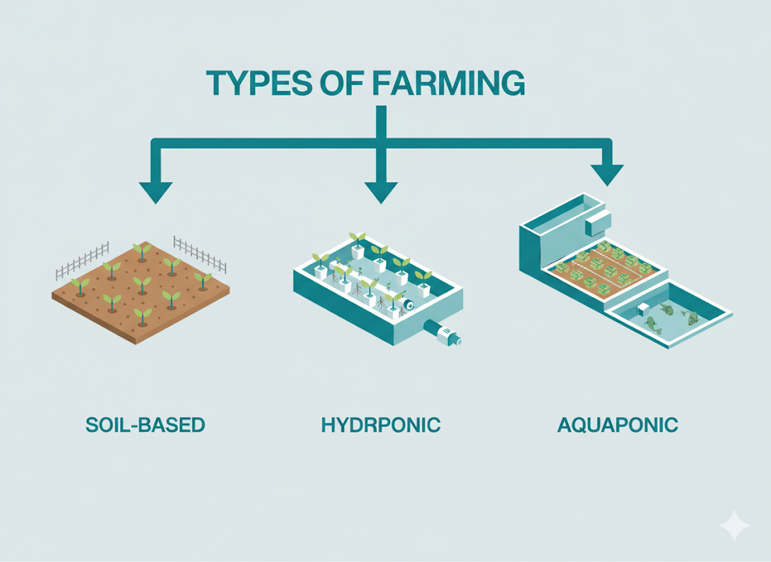

Slide 12

Team
Ahmed Hassan Saleh
Ahmad Mustafa Elbatanouny
Mahmoud Mohamed AbdElTawab
Special Thanks
Mohamed Badawy
www.reallygreatsite.com
Supervised by
Prof. Dr .Mohamed Said

